Slide 1

8th Grade Math: Pre-Algebra
Unit 9, Lesson 4 Reflections on the Coordinate Plane Volume 2, pg. 76

Slide 2


Benchmark
MA.8.GR.2.3
Describe and apply the effect of a single transformation on two-dimensional figures using coordinates and the coordinate plane.
volume 2, pg. 76

Slide 3
Integrated Mathematical Thinking and Reasoning Standards
MA.K12.MTR.1.1 Actively participate in effortful learning both individually and collectively.
MA.K12.MTR.2.1 Demonstrate understanding by representing problems in multiple ways.
MA.K12.MTR.4.1 Engage in discussions that reflect on the mathematical thinking of self and others.
MA.K12.MTR.7.1 Apply mathematics to real-world contexts.
volume 2, pg. 76

Slide 4

Learning Targets
I can perform a reflection on the coordinate plane.
I can describe relationships between figures after a reflection.
volume 2, pg. 76

Slide 5

Warm-Up
volume 2, pg. 77

Slide 6
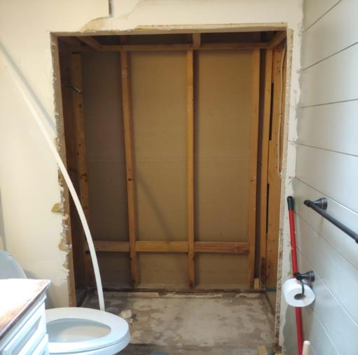
9.4.1 Warm-Up: Think Like a Mathematician
The image shows the beginning of a bathroom remodel.
List some of the mathematics that may be needed to complete a remodel such as this one. Include at least three things on your list.
volume 2, pg. 77

Slide 7

Guided Instruction
volume 2, pg. 77

Slide 8
9.4.2 Guided Instruction: Reflections on the Coordinate Plane
On the coordinate plane shown, $∆NBF$ is reflected to create $∆N′B′F′$.
volume 2, pg. 77

Slide 9
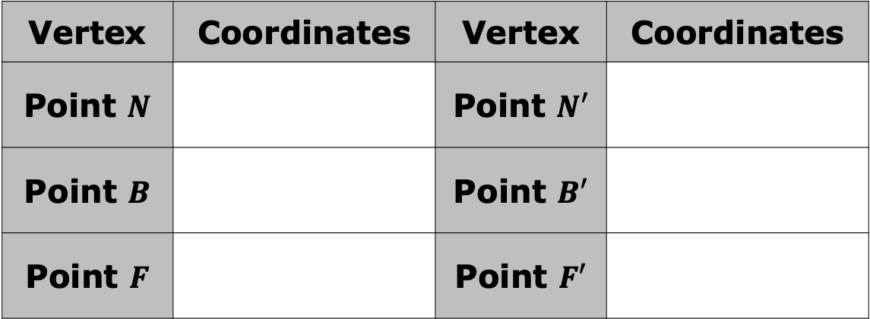
What is the line of reflection?
Complete the table with the coordinates of each vertex.
Vertex | Coordinates | Vertex | Coordinates
Point $N$ |  | Point $N′$
Point $B$ |  | Point $B′$
Point $F$ |  | Point $F′$
volume 2, pg. 77

Slide 10
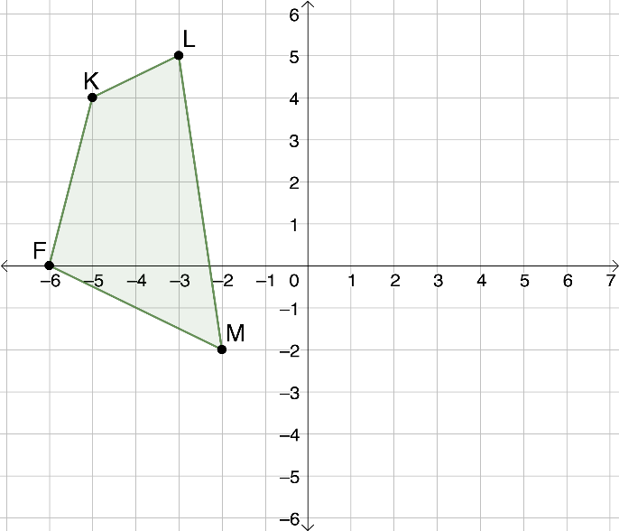
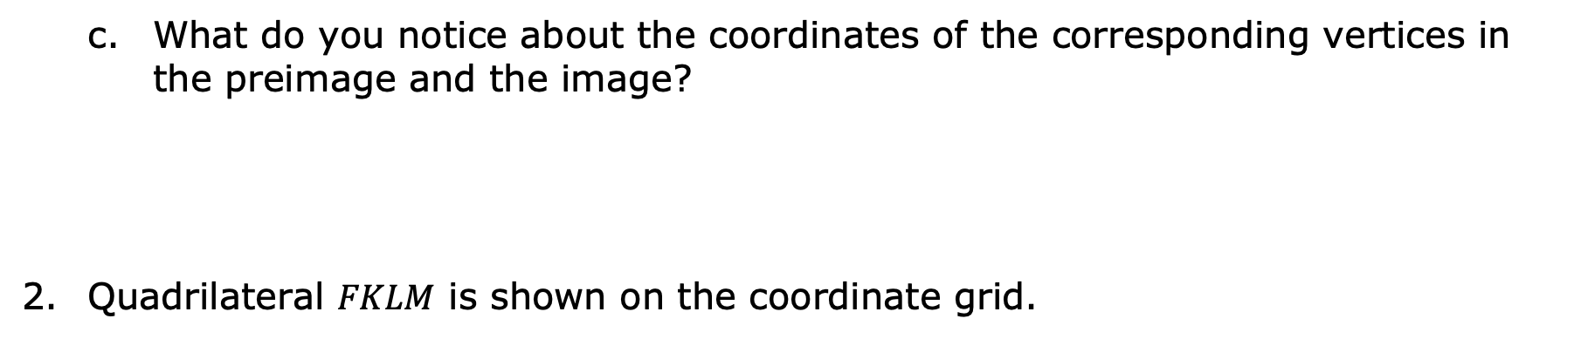
What do you notice about the coordinates of the corresponding vertices in the preimage and the image?
Quadrilateral $FKLM$ is shown on the coordinate grid.
volume 2, pg. 78

Slide 11
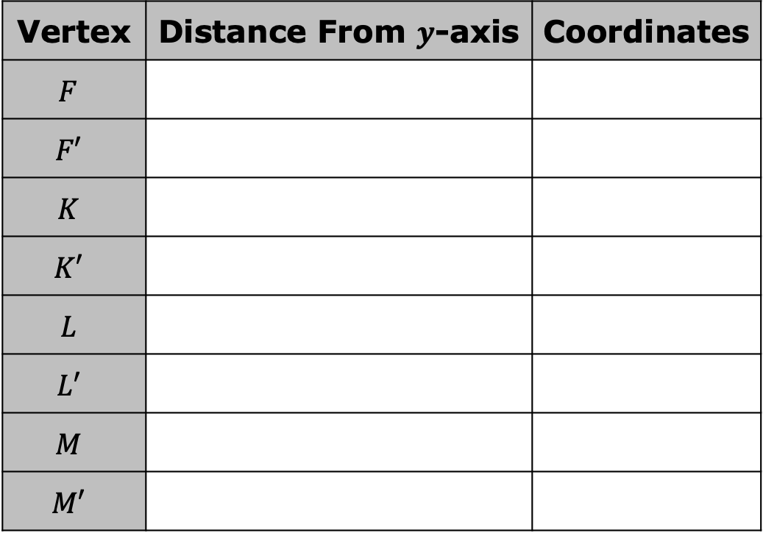
Complete the left side of the table for points $F$, $K$, $L$, and $M$.
Vertex | Distance From $y$-axis | Coordinates
$$F$$
$$F′$$
$$K$$
$$K′$$
$$L$$
$$L′$$
$$M$$
$$M′$$
volume 2, pg. 78

Slide 12
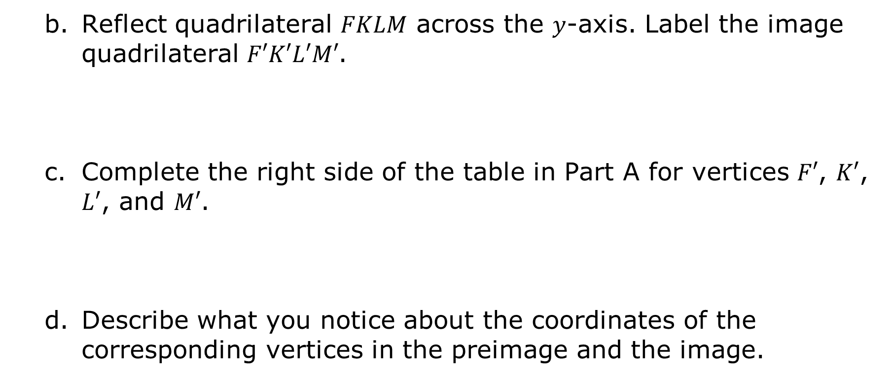
Reflect quadrilateral $FKLM$ across the $y$-axis. Label the image quadrilateral $F′K′L′M′$.
Complete the right side of the table in Part A for vertices $F′$, $K′$, $L′$, and $M′$.
Describe what you notice about the coordinates of the corresponding vertices in the preimage and the image.
volume 2, pg. 78

Slide 13
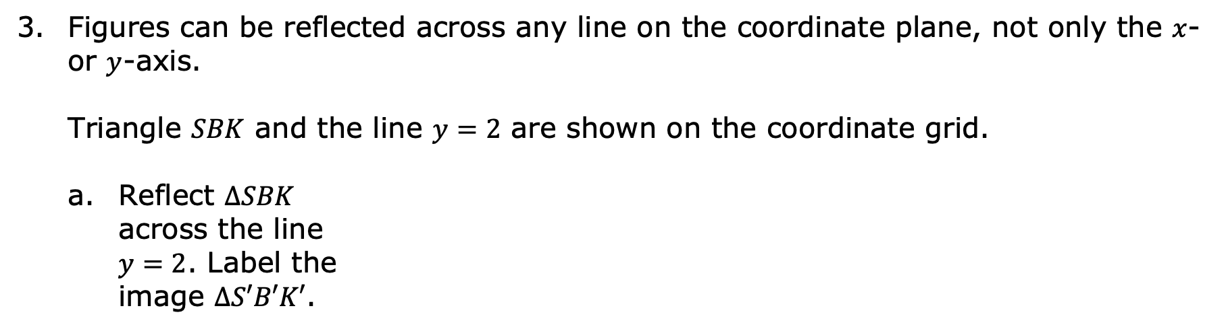
Figures can be reflected across any line on the coordinate plane, not only the $x$- or $y$-axis.
Triangle $SBK$ and the line $y=2$ are shown on the coordinate grid.
Reflect $∆SBK$ across the line $y=2$. Label the image $∆S′B′K′$.
volume 2, pg. 78

Slide 14


Complete the table with the coordinates of the vertices of the preimage and image.
Describe the relationship between the coordinates of points $B$ and $B′$.
Vertex | Coordinates | Vertex | Coordinates
Point $S$ |  | Point $S′$
Point $B$ |  | Point $B′$
Point $K$ |  | Point $K′$
volume 2, pg. 79

Slide 15

Collaboration
volume 2, pg. 79

Slide 16


9.4.3 Collaboration: Which Quadrant?
A triangle is shown on the coordinate plane.
Without performing the transformation, discuss with your partner what the image of the triangle would look like after a reflection across the $y$-axis.
volume 2, pg. 79

Slide 17
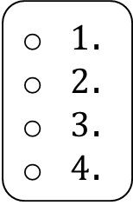
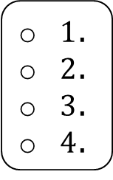
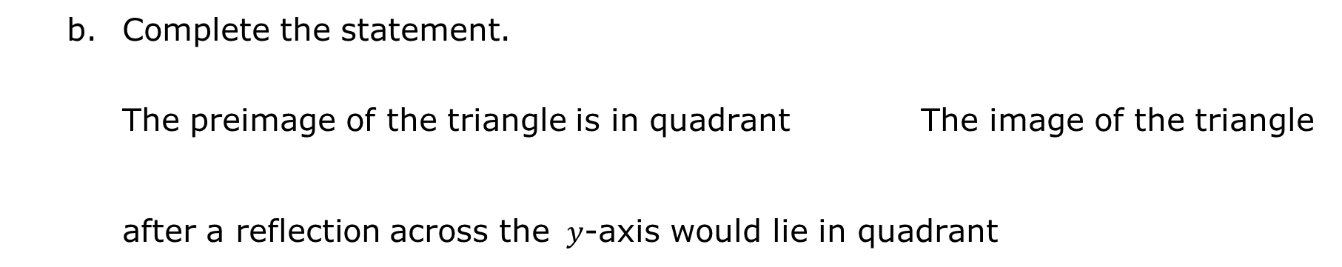
Complete the statement.
The preimage of the triangle is in quadrant The image of the triangle after a reflection across the $y$-axis would lie in quadrant
$1$.
$2$.
$3$.
$4$.
$1$.
$2$.
$3$.
$4$.
volume 2, pg. 79

Slide 18
A quadrilateral is shown on the coordinate plane.
volume 2, pg. 80

Slide 19
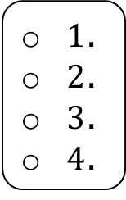
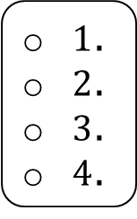
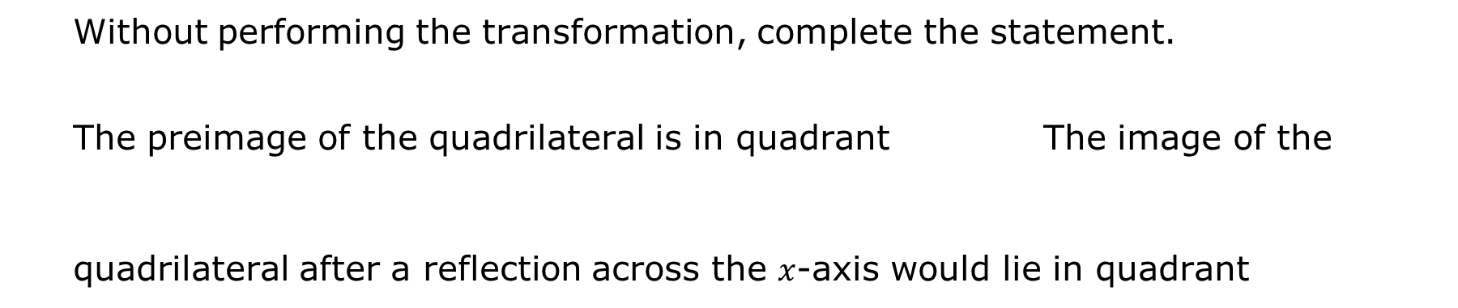
Without performing the transformation, complete the statement.
The preimage of the quadrilateral is in quadrant The image of the quadrilateral after a reflection across the $x$-axis would lie in quadrant
$1$.
$2$.
$3$.
$4$.
$1$.
$2$.
$3$.
$4$.
volume 2, pg. 80

Slide 20

Your Turn
volume 2, pg. 80

Slide 21
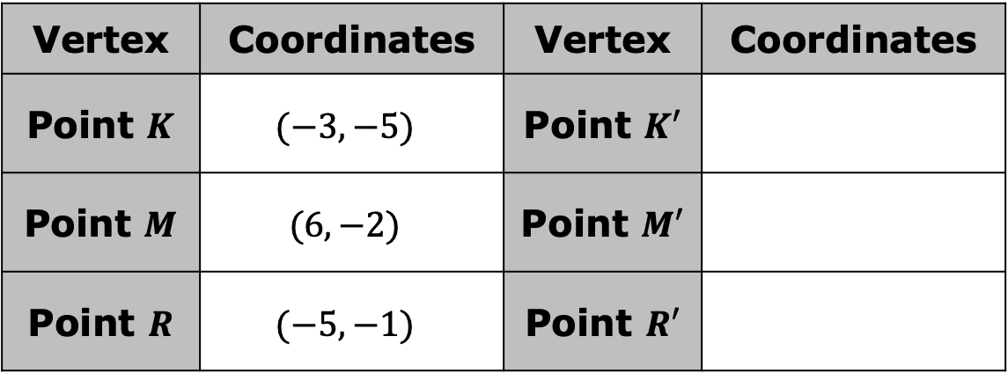
9.4.4 Your Turn!
The vertices of $∆KMR$ have their coordinates given in the table.
Vertex | Coordinates | Vertex | Coordinates
Point $K$ | $$(−3, −5)$$ | Point $K′$
Point $M$ | $$(6, −2)$$ | Point $M′$
Point $R$ | $$(−5, −1)$$ | Point $R′$
volume 2, pg. 80

Slide 22
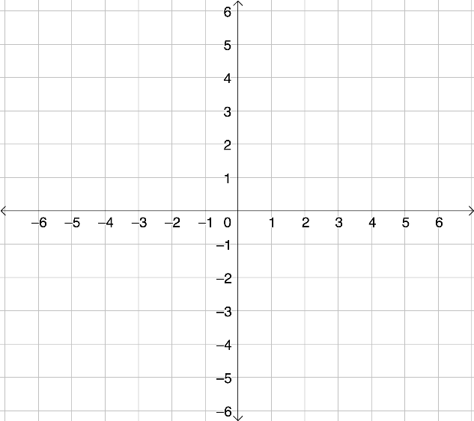

Plot $∆KMR$ on the coordinate grid.
Reflect $∆KMR$ across the $x$-axis. Label the image $∆K′M′R′$.
Complete the table above for the image.
Describe the relationship between the corresponding vertices of the preimage and image.
volume 2, pg. 80

Slide 23
Quadrilateral $RDLN$ and line $x=−1$ are shown on the coordinate grid.
volume 2, pg. 81

Slide 24
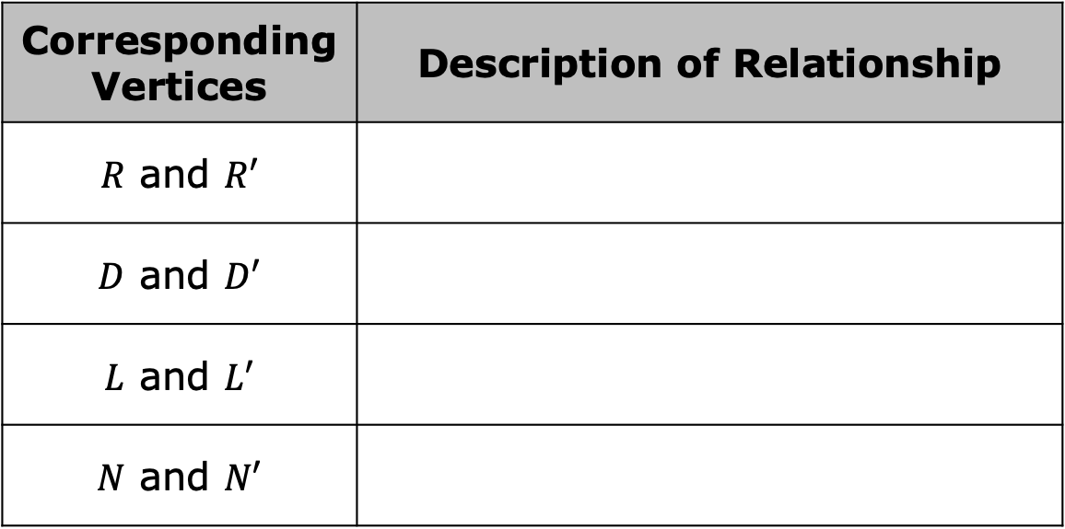
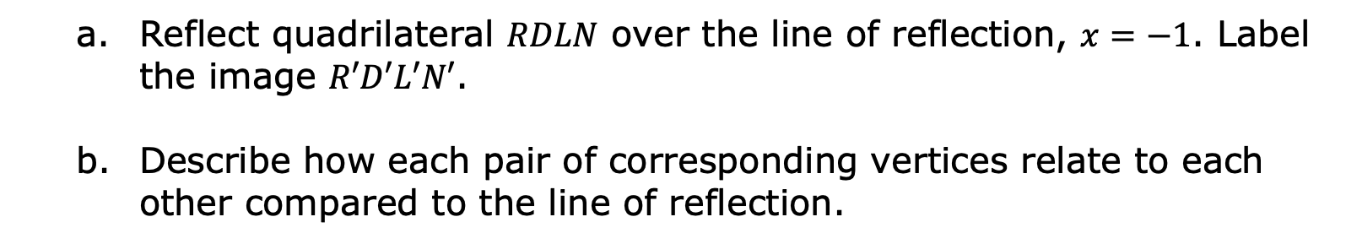
Reflect quadrilateral $RDLN$ over the line of reflection, $x=−1$. Label the image $R′D′L′N′$.
Describe how each pair of corresponding vertices relate to each other compared to the line of reflection.
Corresponding Vertices | Description of Relationship
$R$ and $R′$
$D$ and $D′$
$L$ and $L′$
$N$ and $N′$
volume 2, pg. 81

Slide 25

Wrap-Up
volume 2, pg. 81

Slide 26
9.4.5 Wrap-Up: Reflection
Complete each statement as you reflect on today’s learning.
When someone asks me what I did in math today, I can say …
The thing that made the most sense to me today was …
Something that I do not understand YET is …
volume 2, pg. 81

